Slide 1

Spec2Vec
Energy based non-linear Calibration in NIRS
Patrick Michl <patrick.michl@gmail.com>
2022-06-21

Slide 2
Abstract
The success of multivariate calibration depends on the generalizability of the underlying regression models, for which the spectral features are usually decorrelated in a preliminary step. In order to also allow the application of deep neural networks like transformers, this presentation introduces a powerful approach to highly non-linear decorrelation of spectral features using deep energy based modeling.

Slide 3
Outline
NIR Spectroscopy

Slide 4
Outline
Multivariate Calibration

Slide 5
Outline
Energy based Calibration

Slide 6
Outline
Non-linear Feature Selection

Slide 7
Outline
Bayesian Sample Selection

Slide 8
NIR Spectroscopy
Part 1
NIR Spectroscopy

Slide 9
NIR Spectroscopy
What is NIR?

Slide 10
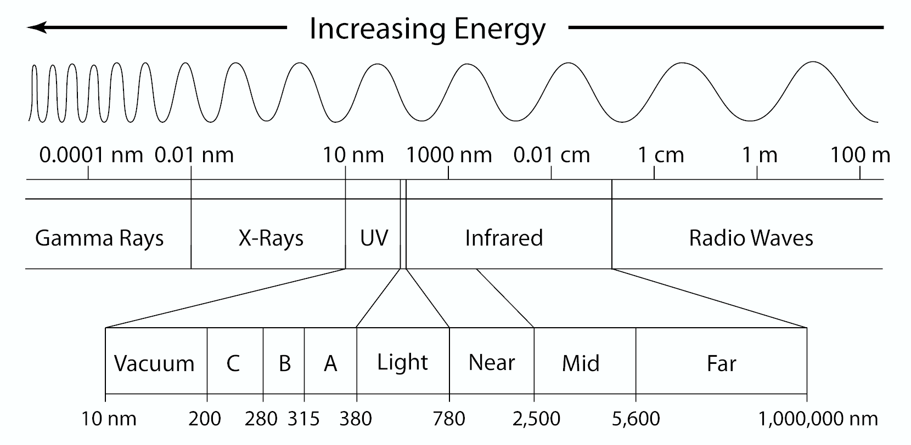
NIR Spectroscopy
What is NIR?
NIR = Near Infrared
Region in the EM spectrum

Slide 11
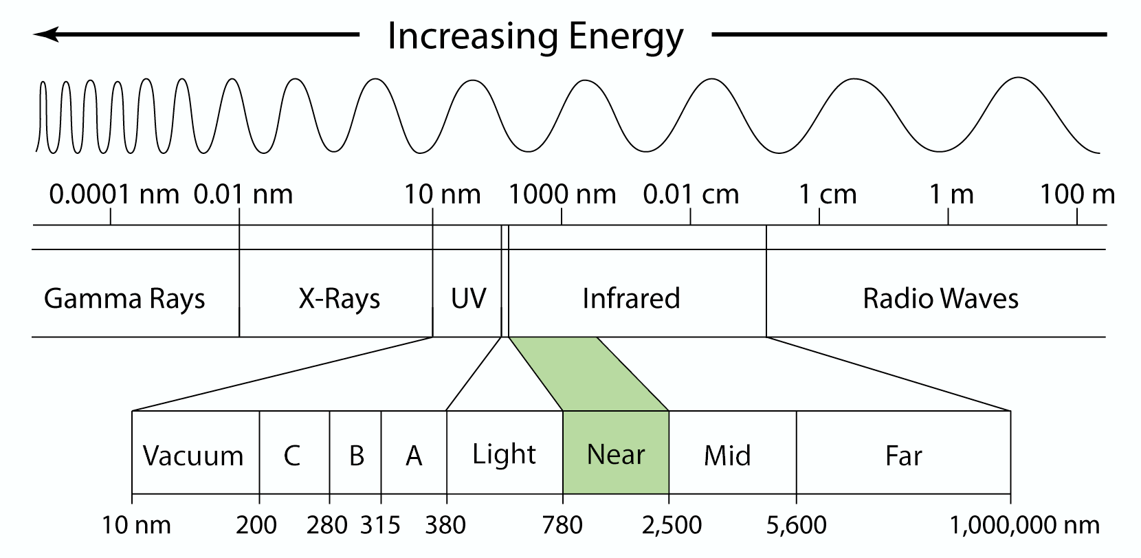
NIR Spectroscopy
What is NIR?
NIR = Near Infrared
Region in the EM spectrum
Ranging
from ~780nm to ~2500nm

Slide 12
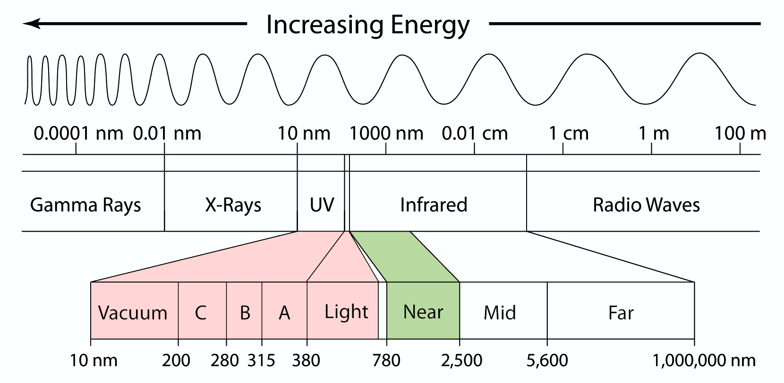
NIR Spectroscopy
What is NIR?
NIR = Near Infrared
Region in the EM spectrum
Ranging
from ~780nm to ~2500nm
No Atomic Spectral Lines
Eigenstates have transitions at typical wavelengths: ~10nm to ~750nm

Slide 13
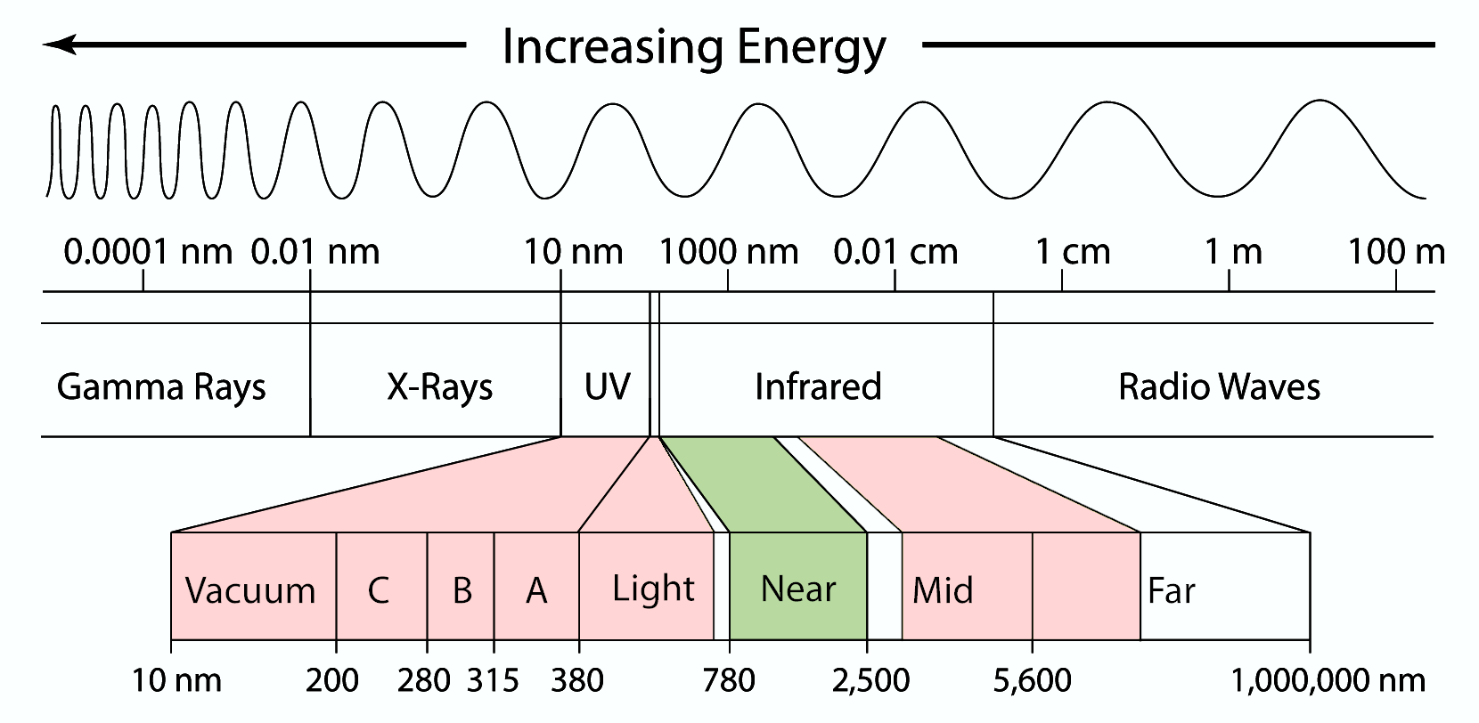
NIR Spectroscopy
What is NIR?
NIR = Near Infrared
Region in the EM spectrum
Ranging
from ~780nm to ~2500nm
No Excited Atoms
Eigenstates have transitions at typical wavelengths: ~10nm to ~750nm
No Molecule Vibrations
Eigenfrequencies of bonds are typically at wavelengths: ~3000nm to ~30000nm

Slide 14
NIR Spectroscopy
What is NIR?
NIR = Near Infrared
Region in the EM spectrum
Ranging
from ~780nm to ~2500nm
No Excited Atoms
Eigenstates have transitions at typical wavelengths: ~10nm to ~750nm
No Fundamental Spectral Lines!
No Molecule Vibrations
Eigenfrequencies of bonds are typically at wavelengths: ~3000nm to ~30000nm

Slide 15
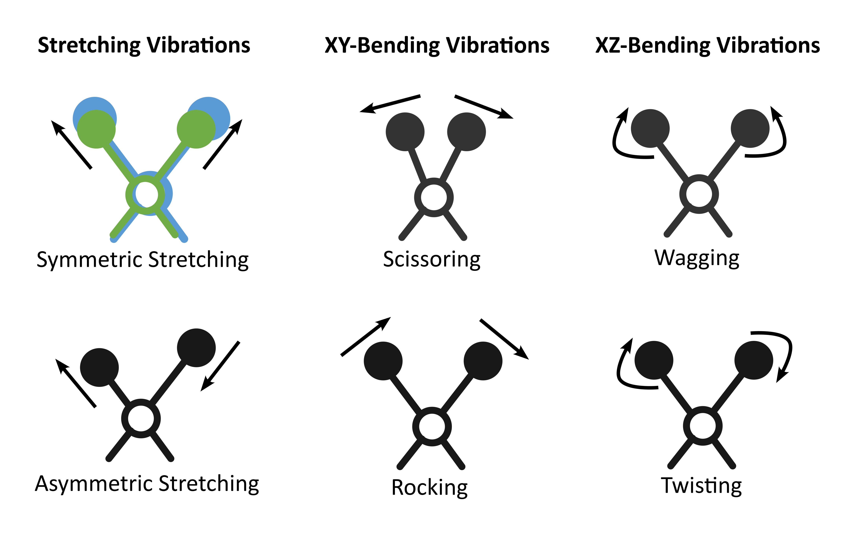
NIR Spectroscopy
What is NIR?
NIR = Near Infrared
Region in the EM spectrum
Ranging
from ~780nm to ~2500nm
No Excited Atoms
Eigenstates have transitions at typical wavelengths: ~10nm to ~750nm
No Fundamental Spectral Lines!
No Molecule Vibrations
Eigenfrequencies of bonds are typically at wavelengths: ~3000nm to ~30000nm
Vibrational Overtones
Vibration modes provide higher modes. 2nd modes are about 10-100x weaker than fundamental modes

Slide 16
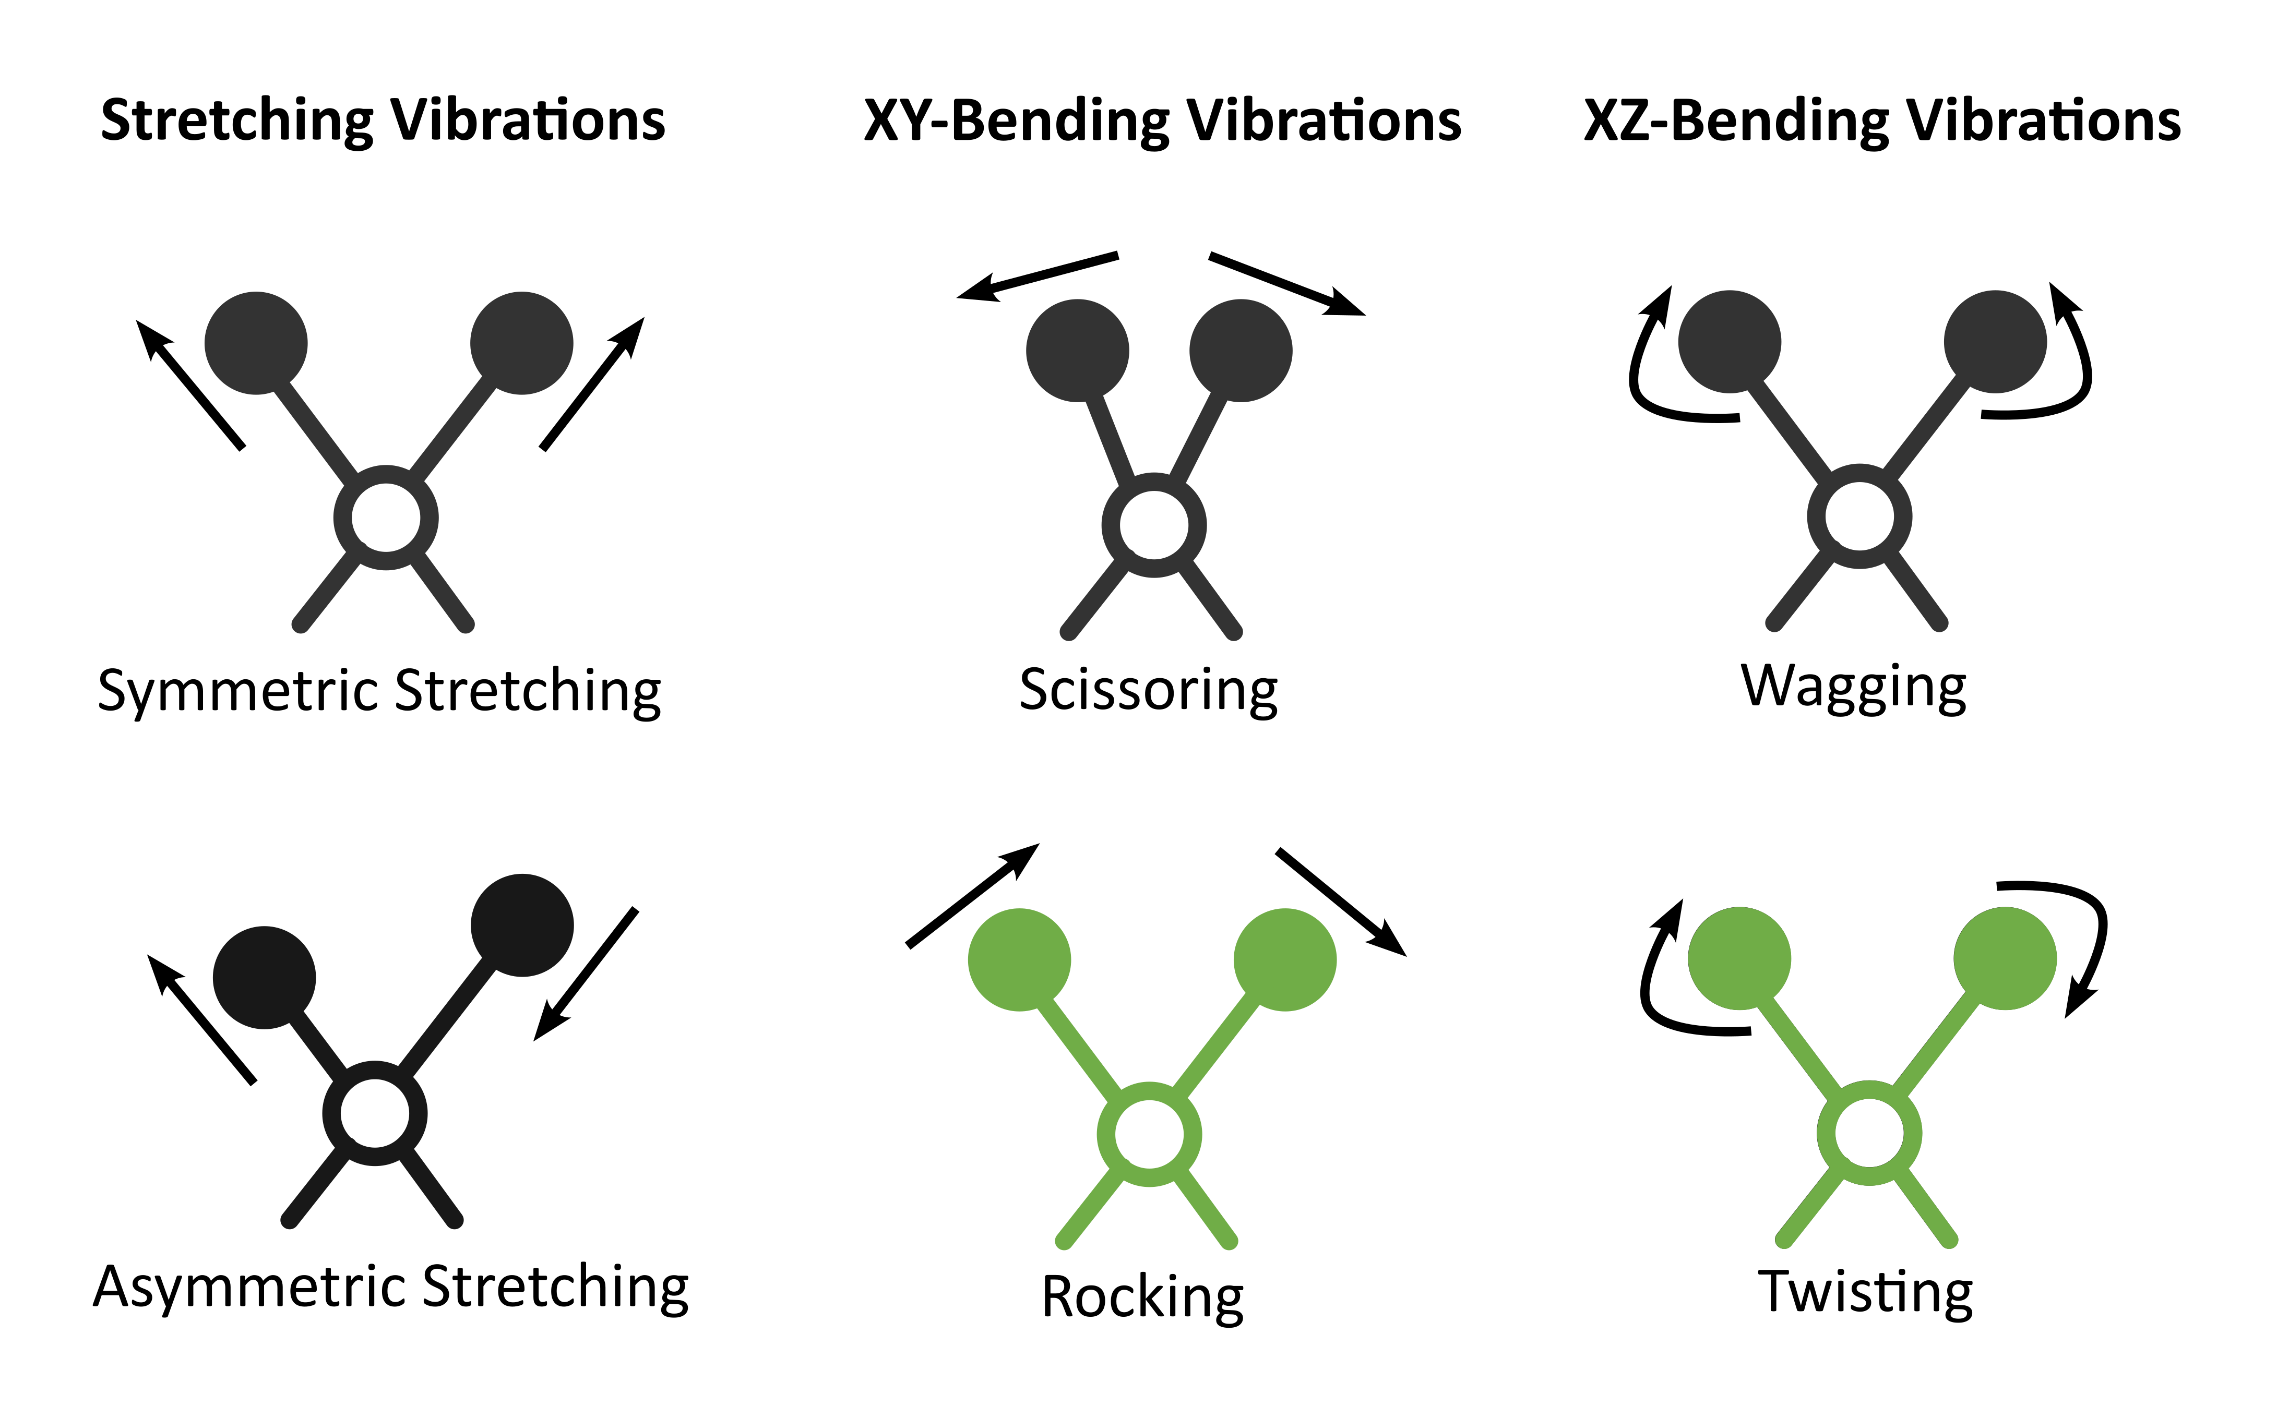
NIR Spectroscopy
What is NIR?
NIR = Near Infrared
Region in the EM spectrum
Ranging
from ~780nm to ~2500nm
No Excited Atoms
Eigenstates have transitions at typical wavelengths: ~10nm to ~750nm
No Fundamental Spectral Lines!
No Molecule Vibrations
Eigenfrequencies of bonds are typically at wavelengths: ~3000nm to ~30000nm
Vibrational Overtones
Vibration modes provide higher modes. 2nd modes are about 10-100x weaker than fundamental modes
Combination Modes
12 possible pairwise combinations of fundamental modes with highly unspecific (broad) bands

Slide 17
NIR Spectroscopy
What can be concluded about NIR?

Slide 18
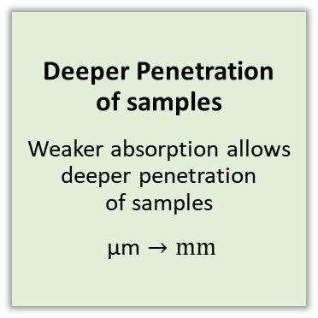
NIR Spectroscopy
Conclusions
Deeper Penetration of samples
Weaker absorption allows deeper penetration of samples
$\text{µ}\text{m}→mm$

Slide 19
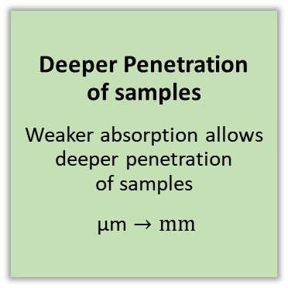
NIR Spectroscopy
Conclusions
Simpler Preparation
Due to deeper penetration the sample surface is less cruzial
Deeper Penetration of samples
Weaker absorption allows deeper penetration of samples
$\text{µ}\text{m}→mm$

Slide 20
NIR Spectroscopy
Conclusions
Simpler Preparation
Due to deeper penetration the sample surface is less cruzial
Deeper Penetration of samples
Weaker absorption allows deeper penetration of samples
$\text{µ}\text{m}→mm$
Condensed Information
Overlapping bands of deeper penetrations provide comprehensive information within the NIR region

Slide 21
NIR Spectroscopy
Conclusions
Simpler Preparation
Due to deeper penetration the sample surface is less cruzial
Unspecific Features
Due to overlapping, individual spectral features are insufficient for the prediction of chemical features
Deeper Penetration of samples
Weaker absorption allows deeper penetration of samples
$\text{µ}\text{m}→mm$
Condensed Information
Overlapping bands of deeper penetrations provide comprehensive information within the NIR region

Slide 22
NIR Spectroscopy
Conclusions
Simpler Preparation
Due to deeper penetration the sample surface is less cruzial
Unspecific Features
Due to overlapping, individual spectral features are insufficient for the prediction of chemical features
Deeper Penetration of samples
Weaker absorption allows deeper penetration of samples
$\text{µ}\text{m}→mm$
Interpretability of spectra?
Condensed Information
Overlapping bands of deeper penetrations provide comprehensive information within the NIR region

Slide 23
Multivariate Calibration
Part 2
Multivariate Calibration

Slide 24
Multivariate Calibration
What is the General Setup?

Slide 25
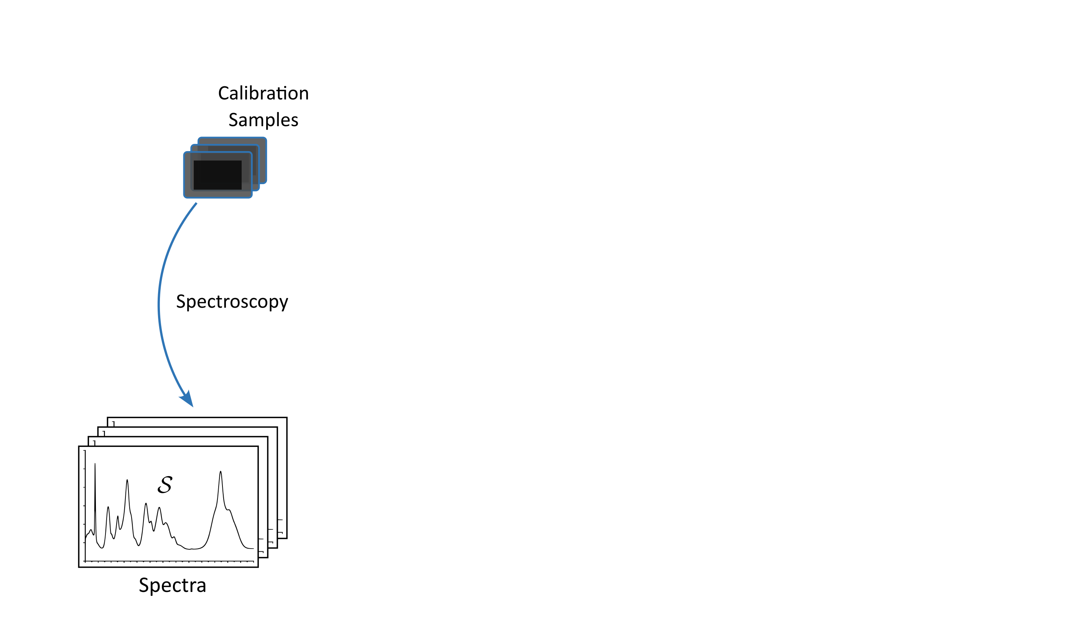
Multivariate Calibration
General Setup
Spectroscopy

Slide 26
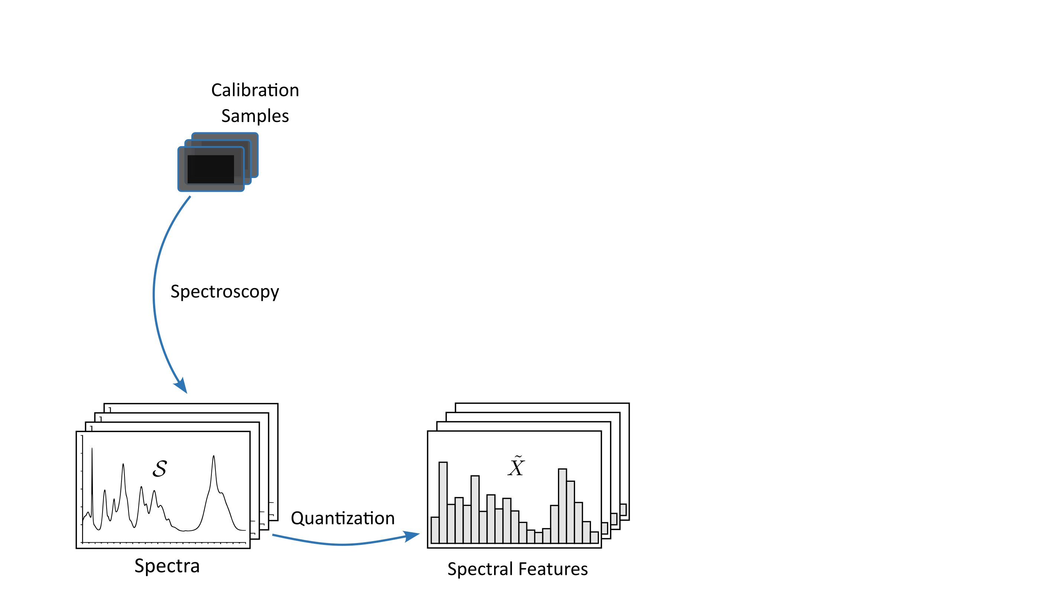
Multivariate Calibration
General Setup
Spectroscopy
Quantization

Slide 27
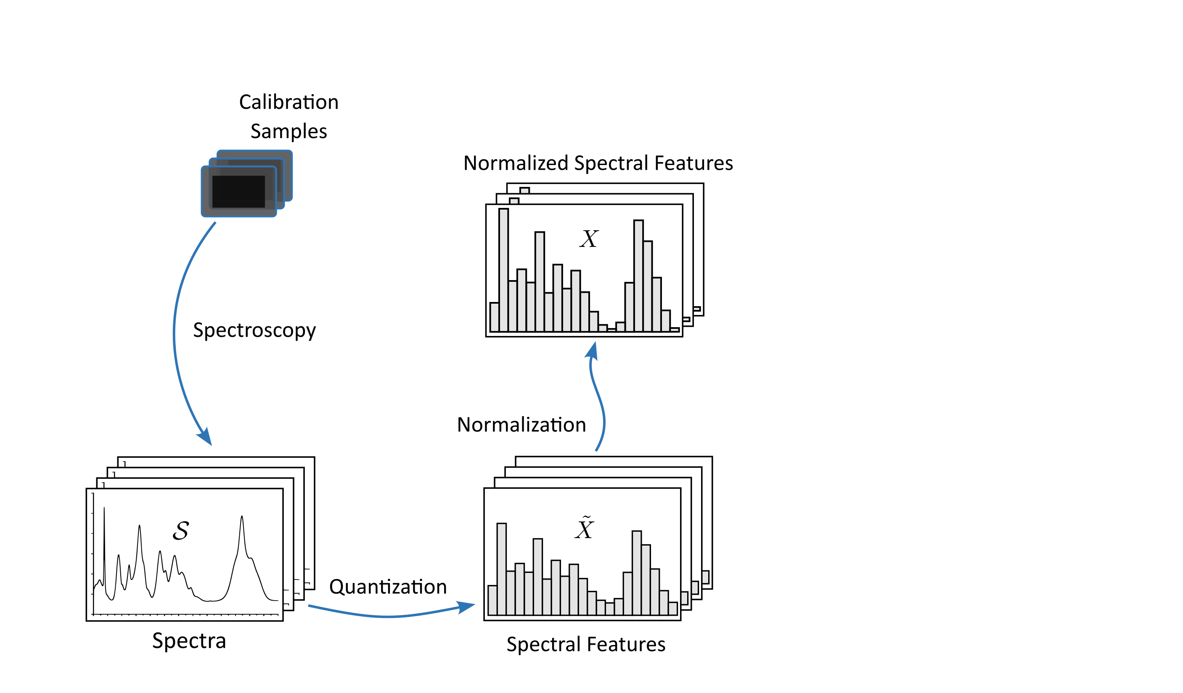
Multivariate Calibration
General Setup
Spectroscopy
Quantization
Normalization

Slide 28
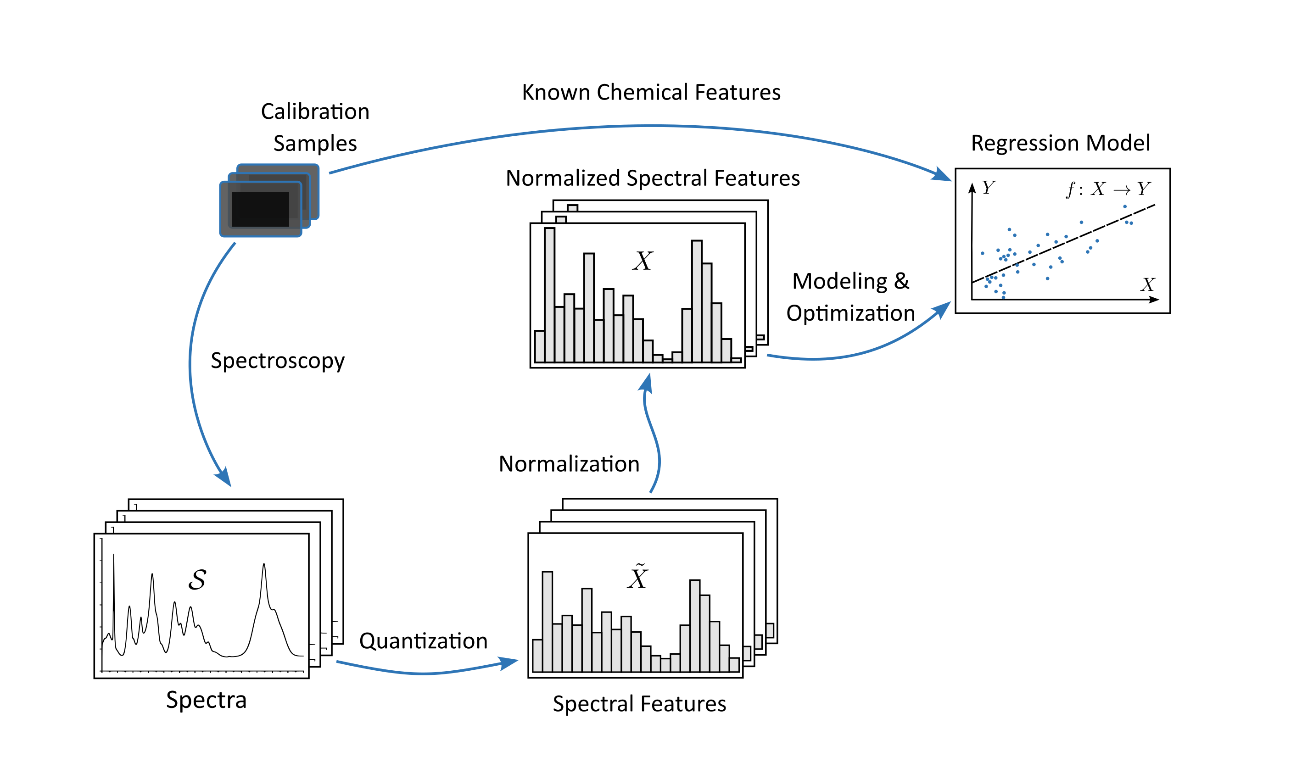
Multivariate Calibration
General Setup
Spectroscopy
Quantization
Normalization
Modeling & Optimization

Slide 29
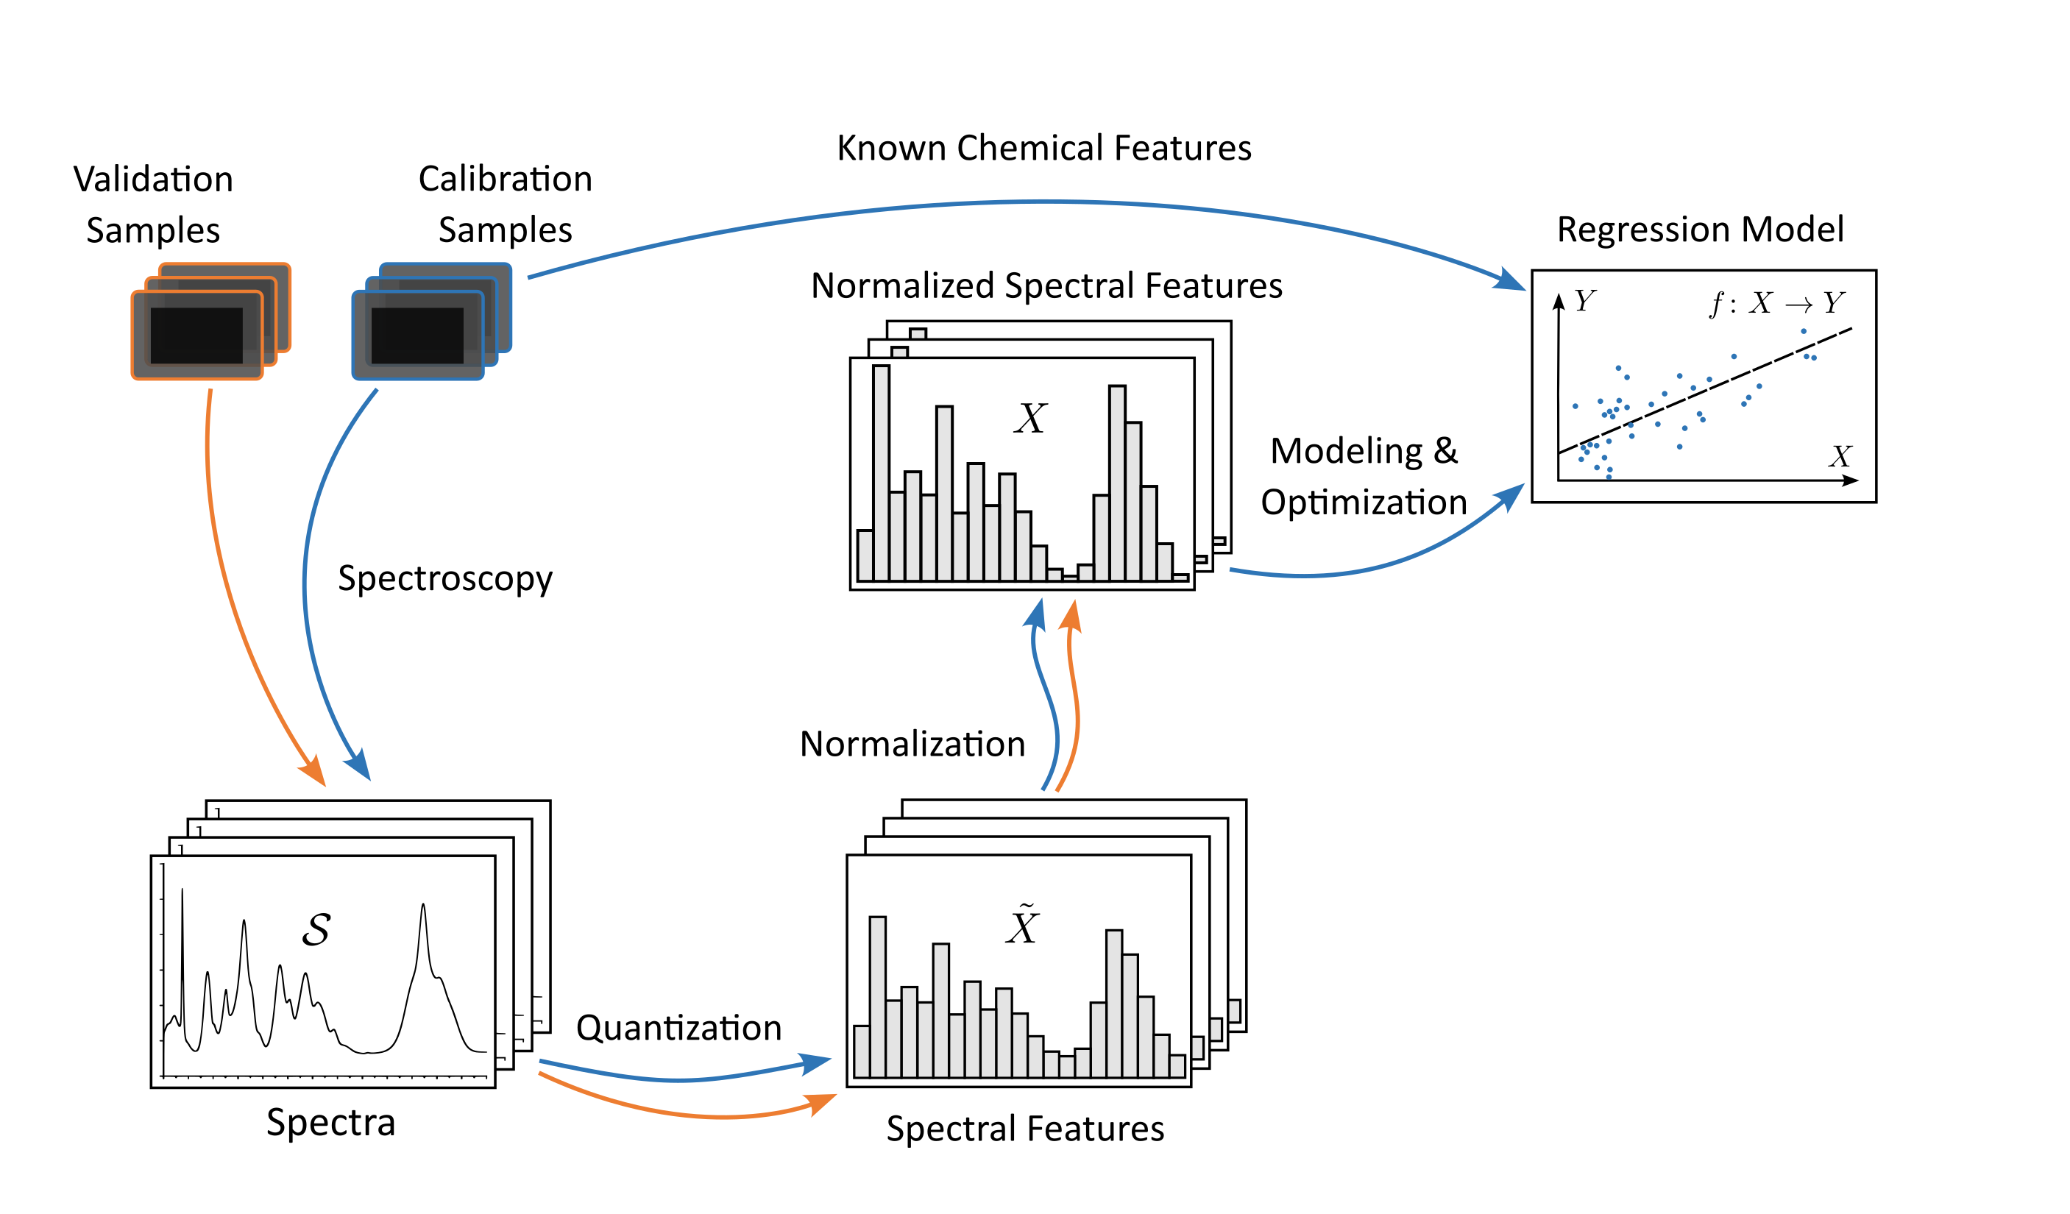
Multivariate Calibration
General Setup
Spectroscopy
Quantization
Normalization
Modeling & Optimization
Validation

Slide 30
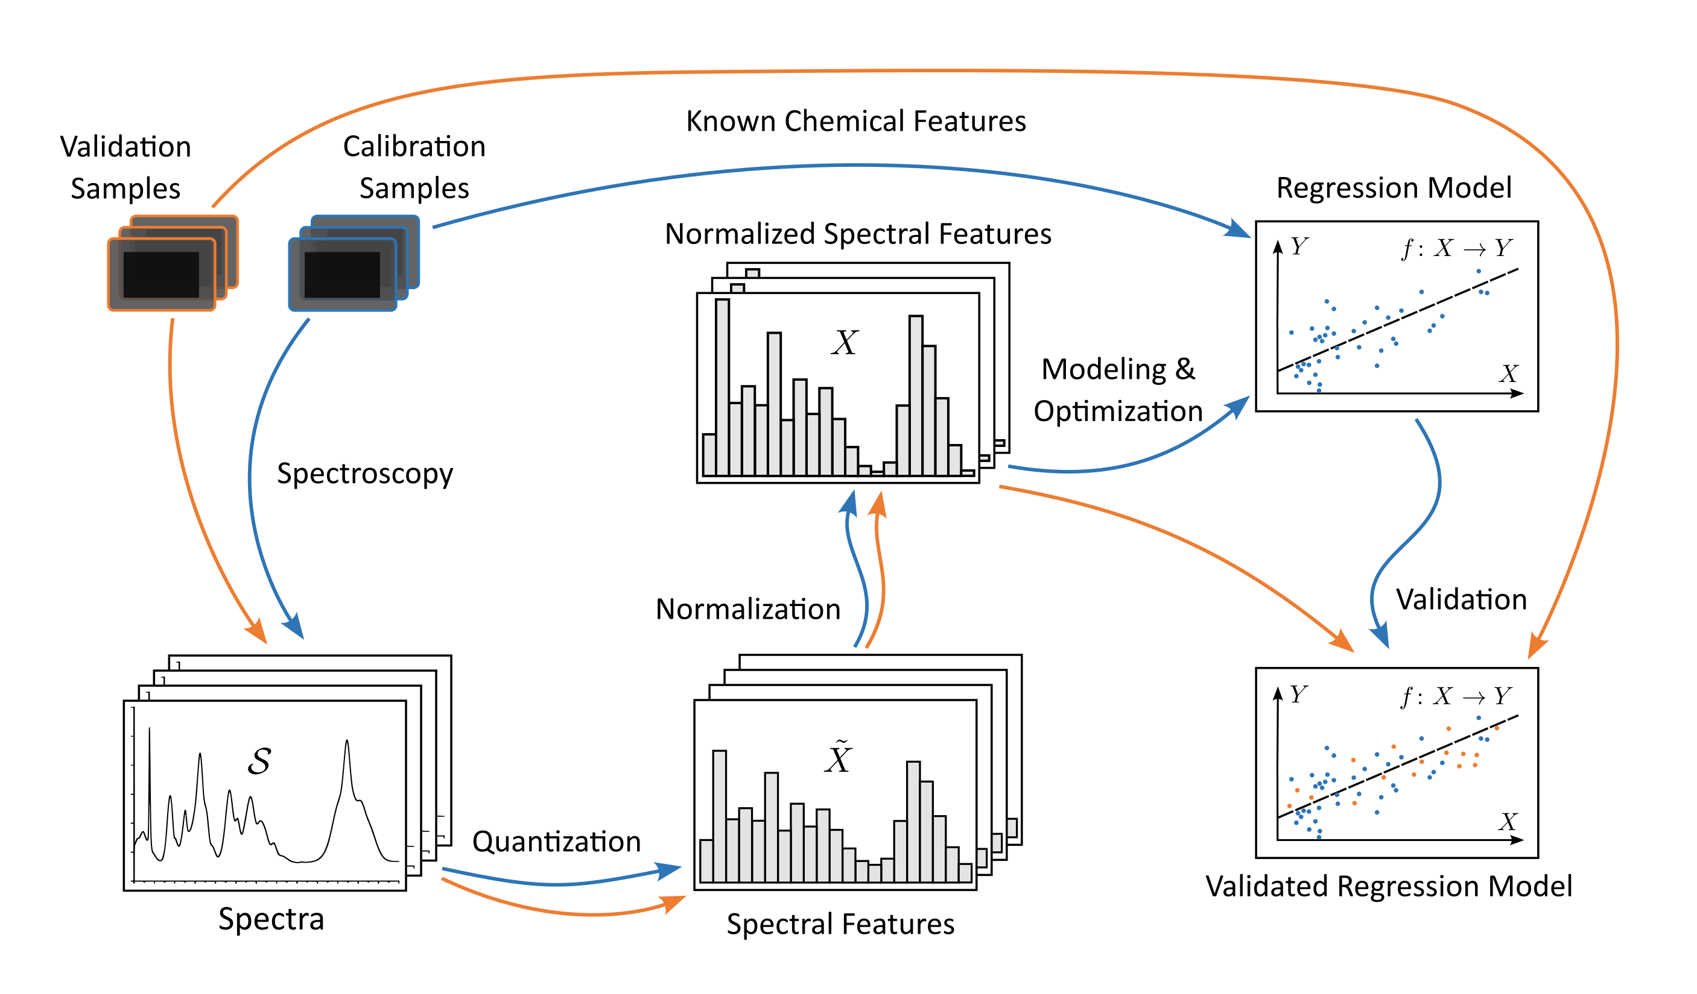
Multivariate Calibration
General Setup
Spectroscopy
Quantization
Normalization
Modeling & Optimization
Validation

Slide 31
Multivariate Calibration
What are the tools in Statistical Modeling?

Slide 32
Multivariate Calibration
Statistical Modeling
Approach 1: Multiple Linear Regression
Linear Superposition!
Model chemical features by superpositions of spectral features

Slide 33
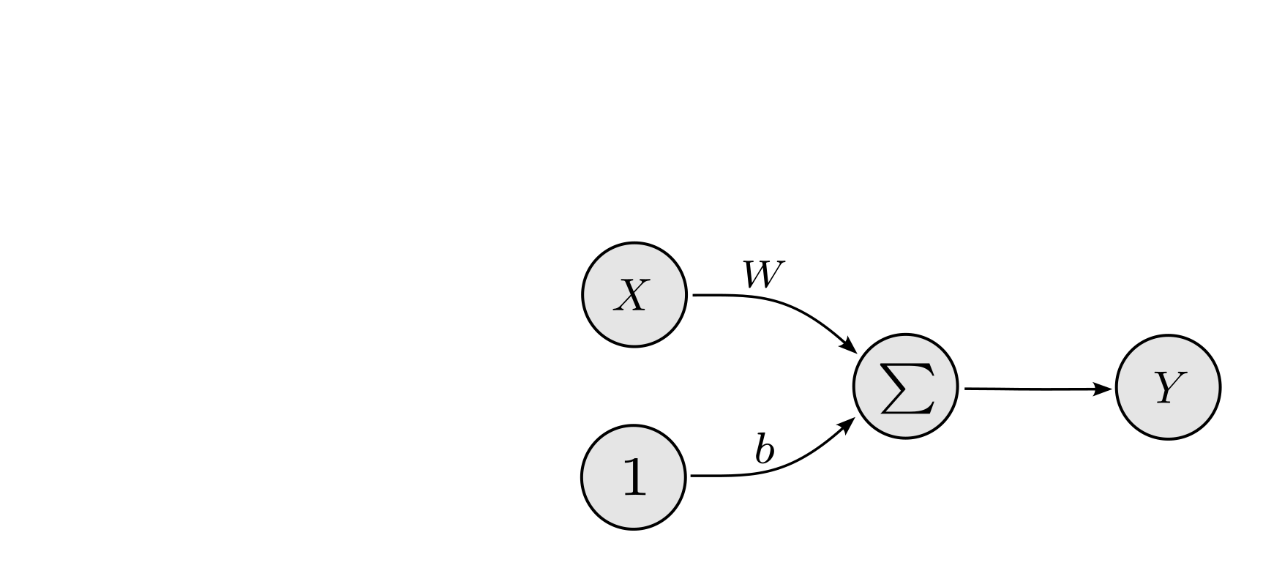
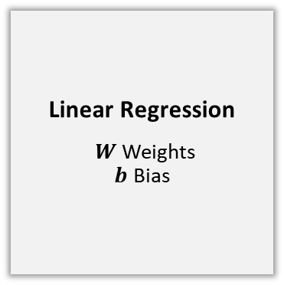
Multivariate Calibration
Statistical Modeling
Approach 1: Multiple Linear Regression
Linear Superposition!
Model chemical features by superpositions of spectral features
Linear Regression
$W$ Weights $b$ Bias

Slide 34
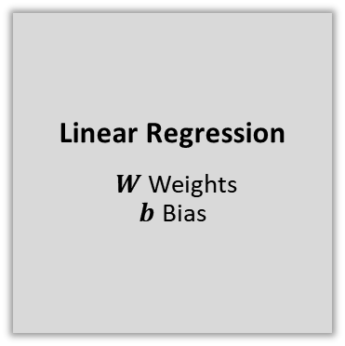
Multivariate Calibration
Statistical Modeling
Approach 1: Multiple Linear Regression
Linear Superposition!
Model chemical features by superpositions of spectral features
Not Generalizable!
Due to multicollinearity
Linear Regression
$W$ Weights $b$ Bias

Slide 35
Multivariate Calibration
Statistical Modeling
Approach 1: Multiple Linear Regression
Linear Decorrelation!
Decorrelate spectral features by orthogonal components

Slide 36
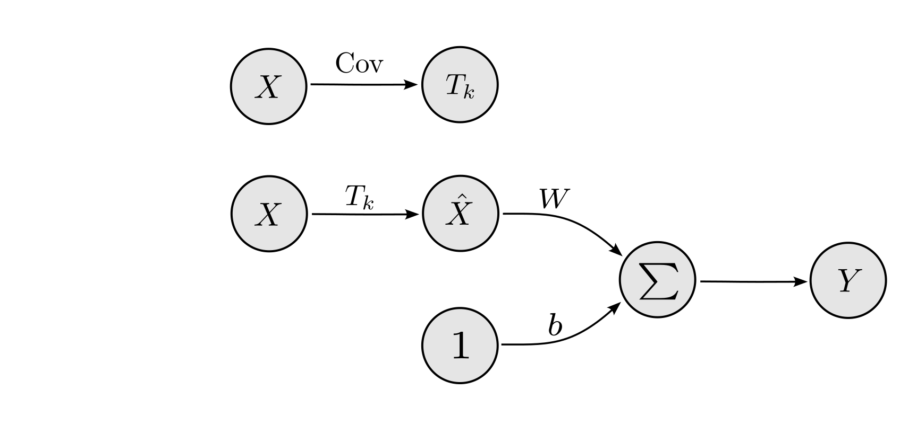
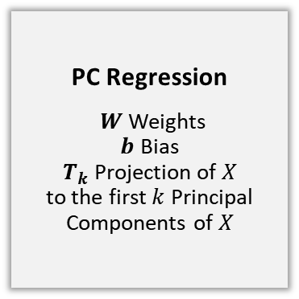
Multivariate Calibration
Statistical Modeling
Approach 2: Principal Component (PC) Regression
Linear Decorrelation!
Decorrelate spectral features by orthogonal components
PC Regression
$W$ Weights $b$ Bias $T_{k}$ Projection of $X$ to the first $k$ Principal Components of $X$

Slide 37
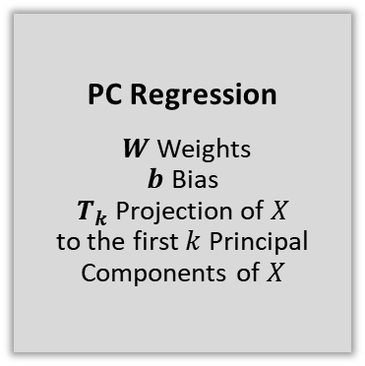
Multivariate Calibration
Statistical Modeling
Approach 2: Principal Component (PC) Regression
Linear Decorrelation!
Decorrelate spectral features by orthogonal components
Not Efficient!
Only accounts for covariances of spectral features
PC Regression
$W$ Weights $b$ Bias $T_{k}$ Projection of $X$ to the first $k$ Principal Components of $X$

Slide 38
Multivariate Calibration
Statistical Modeling
Approach 2: Principal Component (PC) Regression
Incorporate Chemical Features!
Decorrelate the combined vector of spectral features and chemical features

Slide 39
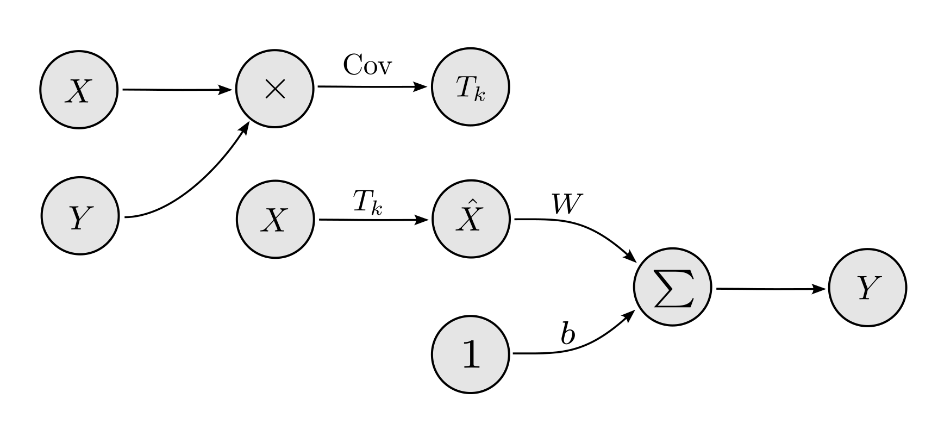
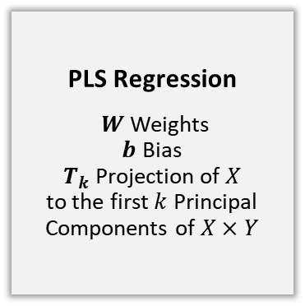
Multivariate Calibration
Statistical Modeling
Approach 3: Partial Least Squares (PLS) Regression
Incorporate Chemical Features!
Decorrelate the combined vector of spectral features and chemical features
PLS Regression
$W$ Weights $b$ Bias $T_{k}$ Projection of $X$ to the first $k$ Principal Components of $X×Y$

Slide 40
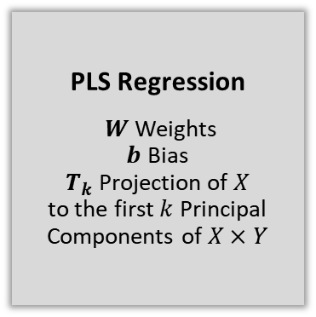
Multivariate Calibration
Statistical Modeling
Approach 3: Partial Least Squares (PLS) Regression
Incorporate Chemical Features!
Decorrelate the combined vector of spectral features and chemical features
Sufficient ?
PLS Regression
$W$ Weights $b$ Bias $T_{k}$ Projection of $X$ to the first $k$ Principal Components of $X×Y$

Slide 41
Multivariate Calibration
Conclusions
What can be concluded about Multivariate Calibration?

Slide 42
Multivariate Calibration
Conclusions
Samples are rare!
The requirement to extract chemical features by wet-lab experiments makes reference samples rare

Slide 43
Multivariate Calibration
Conclusions
Samples are rare!
The requirement to extract chemical features by wet-lab experiments makes reference samples rare
Direct Regression is not possible!
Overlapping and scattered bands create multicollinearity in spectral features

Slide 44
Multivariate Calibration
Conclusions
Samples are rare!
The requirement to extract chemical features by wet-lab experiments makes reference samples rare
Direct Regression is not possible!
Overlapping and scattered bands create multicollinearity in spectral features
Decorrelation in PLS allows efficient linear Regression
A preceeded decorrelation step in PLS allows allows linear regression

Slide 45
Multivariate Calibration
Conclusions
Non-Linear Spectral Dependencies in NIR
Combined vibrational modes in NIR create highly non-linear conditional dependencies between spectral features
Samples are rare!
The requirement to extract chemical features by wet-lab experiments makes reference samples rare
Direct Regression is not possible!
Overlapping and scattered bands create multicollinearity in spectral features
Decorrelation in PLS allows efficient linear Regression
A preceeded decorrelation step in PLS allows allows linear regression

Slide 46
Multivariate Calibration
Conclusions
Non-Linear Spectral Dependencies in NIR
Combined vibrational modes in NIR create highly non-linear conditional dependencies between spectral features
Samples are rare!
The requirement to extract chemical features by wet-lab experiments makes reference samples rare
PLS based non-linear Regression is not possible!
The linear decorrelation step in PLS destroys non-linear relationships
Direct Regression is not possible!
Overlapping and scattered bands create multicollinearity in spectral features
Decorrelation in PLS allows efficient linear Regression
A preceeded decorrelation step in PLS allows allows linear regression

Slide 47
Multivariate Calibration
Conclusions
Non-Linear Spectral Dependencies in NIR
Combined vibrational modes in NIR create highly non-linear conditional dependencies between spectral features
Samples are rare!
The requirement to extract chemical features by wet-lab experiments makes reference samples rare
PLS based non-linear Regression is not possible!
The linear decorrelation step in PLS destroys non-linear relationships
Direct Regression is not possible!
Overlapping and scattered bands create multicollinearity in spectral features
Decorrelation in PLS allows efficient linear Regression
A preceeded decorrelation step in PLS allows allows linear regression
Non-Linear Decorrelation?

Slide 48
Energy based Calibration
Part 3
Energy based Calibration

Slide 49
Energy based Calibration
What is non-linear Decorrelation?

Slide 50
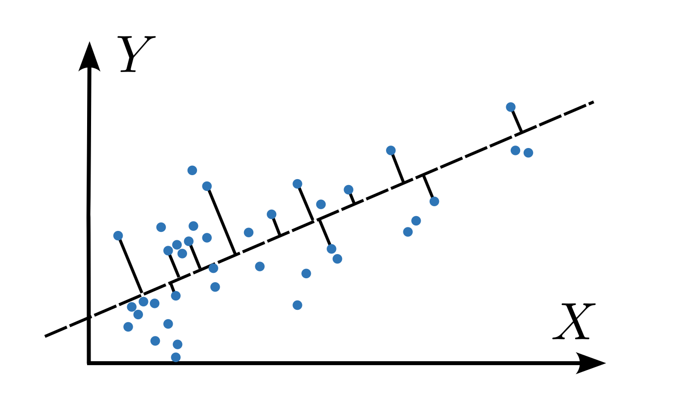
Energy based Calibration
Non-Linear Decorrelation
Linear Correlations
„Multicollinearity“

Slide 51
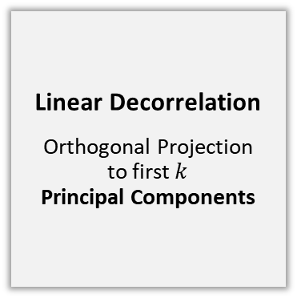
Energy based Calibration
Non-Linear Decorrelation
Linear Correlations
„Multicollinearity“
Linear Decorrelation
Orthogonal Projection to first $k$ Principal Components

Slide 52
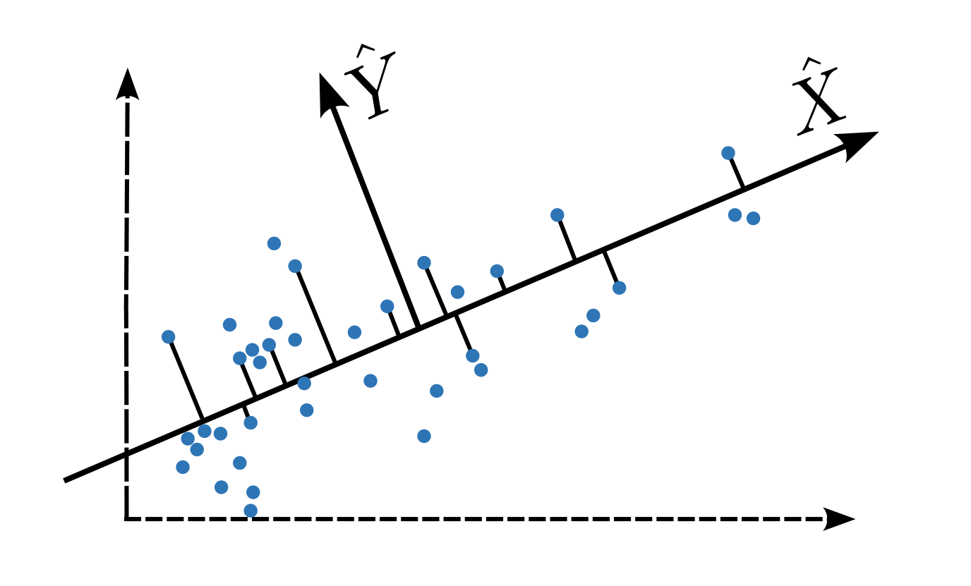
Energy based Calibration
Non-Linear Decorrelation
Linear Correlations
„Multicollinearity“
Linear Decorrelation
Orthogonal Projection to first $k$ Principal Components

Slide 53
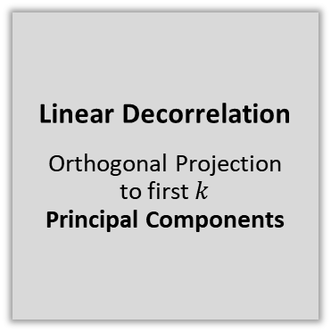
Energy based Calibration
Non-Linear Decorrelation
Linear Correlations
„Multicollinearity“
Allows Linear Regression!
e.g. PC-, PLS-Regression
Linear Decorrelation
Orthogonal Projection to first $k$ Principal Components

Slide 54
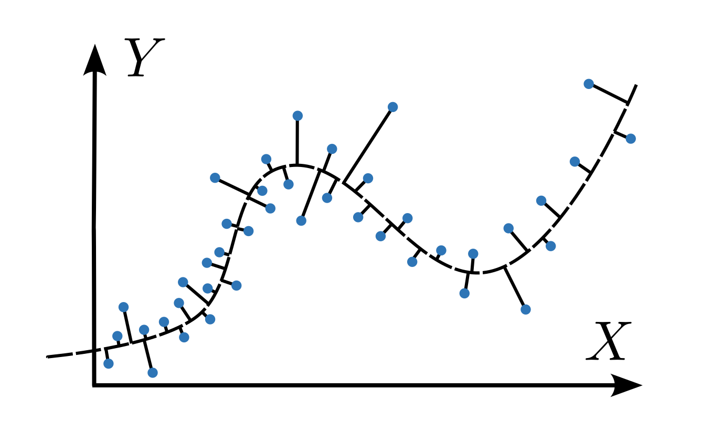
Energy based Calibration
Non-Linear Decorrelation
Generic Correlations
Linear or non-linear

Slide 55
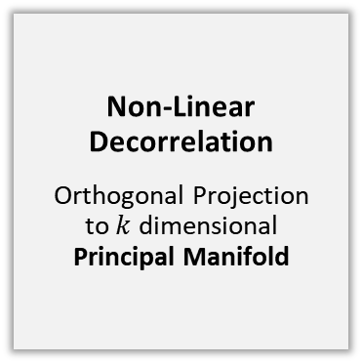
Energy based Calibration
Non-Linear Decorrelation
Generic Correlations
Linear or non-linear
Non-Linear Decorrelation
Orthogonal Projection to $k$ dimensional Principal Manifold

Slide 56
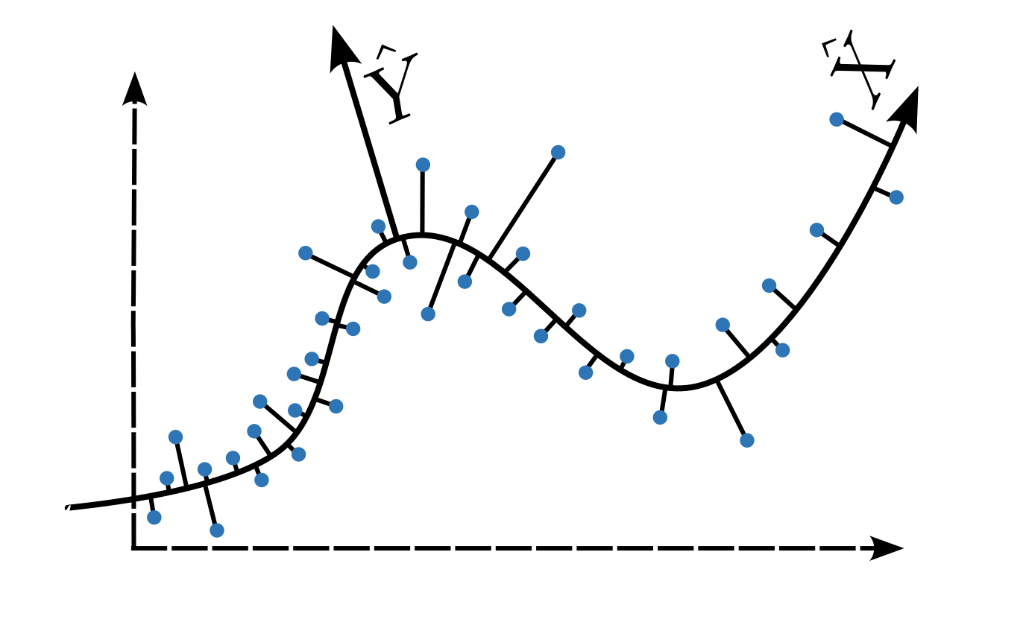
Energy based Calibration
Non-Linear Decorrelation
Generic Correlations
Linear or non-linear
Non-Linear Decorrelation
Orthogonal Projection to $k$ dimensional Principal Manifold

Slide 57
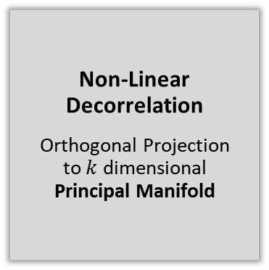
Energy based Calibration
Non-Linear Decorrelation
Generic Correlations
Linear or non-linear
Allows Non-Linear Regression!
e.g. Neural Networks (Transformers etc.)
Non-Linear Decorrelation
Orthogonal Projection to $k$ dimensional Principal Manifold

Slide 58
Energy based Calibration
How to model non-linear Decorrelation?

Slide 59
Energy based Calibration
Modelling Non-Linear Decorrelation
Approach 1: Directed Graphical Model
Directed mapping to latent space
Map features onto itself through a latent bottleneck layer and minimize Error

Slide 60
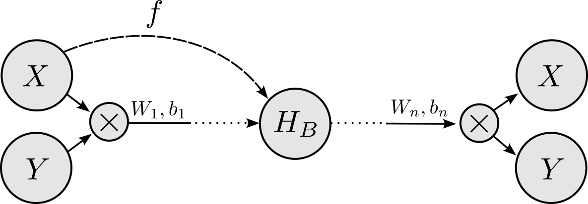
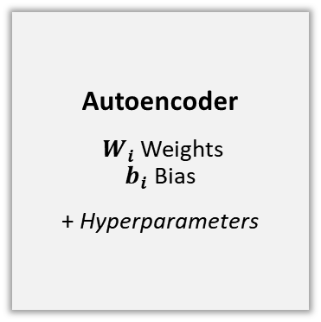
Energy based Calibration
Modelling Non-Linear Decorrelation
Approach 1: Directed Graphical Model
Directed mapping to latent space
Map features onto itself through a latent bottleneck layer and minimize Error
Autoencoder
$W_{i}$ Weights $b_{i}$ Bias
+ Hyperparameters

Slide 61
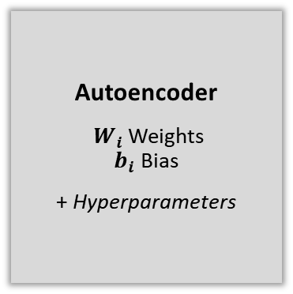
Energy based Calibration
Modelling Non-Linear Decorrelation
Approach 1: Directed Graphical Model
Directed mapping to latent space
Map features onto itself through a latent bottleneck layer and minimize Error
Not Generalizable!
does not equally consider information from different features due to a vanishing error gradient
Autoencoder
$W_{i}$ Weights $b_{i}$ Bias
+ Hyperparameters

Slide 62
Energy based Calibration
Modelling Non-Linear Decorrelation
Approach 1: Directed Graphical Model
?
Directed mapping to latent space
Map features onto itself through a latent bottleneck layer and minimize Error
Not Generalizable!
does not equally consider information from different features due to a vanishing error gradient
Autoencoder
$W_{i}$ Weights $b_{i}$ Bias
+ Hyperparameters

Slide 63
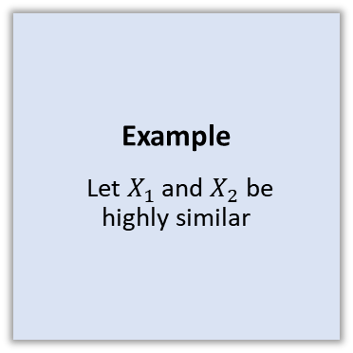
Energy based Calibration
Modelling Non-Linear Decorrelation
Approach 1: Directed Graphical Model
?
Directed mapping to latent space
Map features onto itself through a latent bottleneck layer and minimize Error
Not Generalizable!
does not equally consider information from different features due to a vanishing error gradient
Example
Let $X_{1}$ and $X_{2}$ be highly similar
Autoencoder
$W_{i}$ Weights $b_{i}$ Bias
+ Hyperparameters

Slide 64
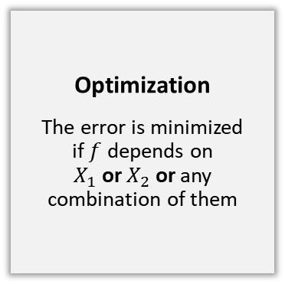
Energy based Calibration
Modelling Non-Linear Decorrelation
Approach 1: Directed Graphical Model
?
Directed mapping to latent space
Map features onto itself through a latent bottleneck layer and minimize Error
Not Generalizable!
does not equally consider information from different features due to a vanishing error gradient
Example
Let $X_{1}$ and $X_{2}$ be highly similar
Autoencoder
$W_{i}$ Weights $b_{i}$ Bias
+ Hyperparameters
Optimization
The error is minimized if $f$ depends on $X_{1}$ or $X_{2}$ or any combination of them

Slide 65
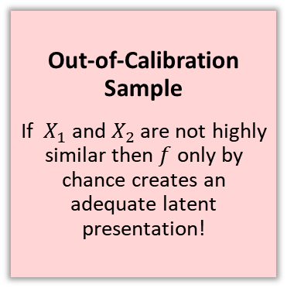
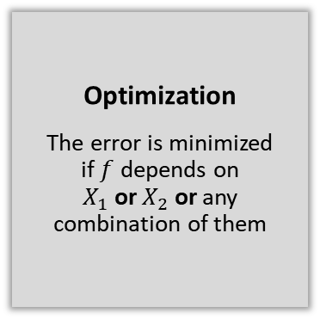
Energy based Calibration
Modelling Non-Linear Decorrelation
Approach 1: Directed Graphical Model
!
Directed mapping to latent space
Map features onto itself through a latent bottleneck layer and minimize Error
Not Generalizable!
does not equally consider information from different features due to a vanishing error gradient
Example
Let $X_{1}$ and $X_{2}$ be highly similar
Out-of-Calibration Sample
If $X_{1}$ and $X_{2}$ are not highly similar then $f$ only by chance creates an adequate latent presentation!
Autoencoder
$W_{i}$ Weights $b_{i}$ Bias
+ Hyperparameters
Optimization
The error is minimized if $f$ depends on $X_{1}$ or $X_{2}$ or any combination of them

Slide 66
Energy based Calibration
Modelling Non-Linear Decorrelation
Approach 1: Directed Graphical Model

Slide 67
Energy based Calibration
Modelling Non-Linear Decorrelation
Approach 2: Undirected Graphical Model
Undirected mapping to latent space
Regard the mapping between features and the bottleneck layer mutually and minimize Energy

Slide 68
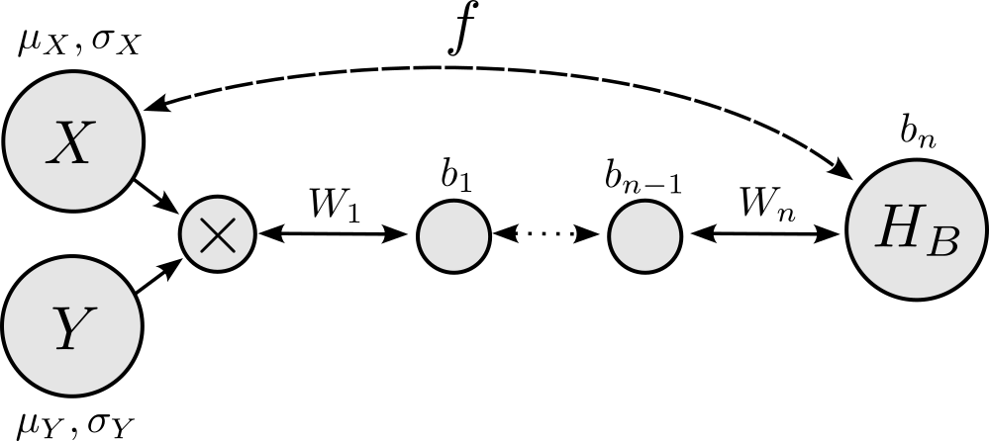
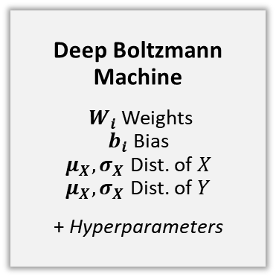
Energy based Calibration
Modelling Non-Linear Decorrelation
Approach 2: Undirected Graphical Model
Undirected mapping to latent space
Regard the mapping between features and the bottleneck layer mutually and minimize Energy
Deep Boltzmann Machine
$W_{i}$ Weights $b_{i}$ Bias $μ_{X},σ_{X}$ Dist. of $X$ $μ_{X},σ_{X}$ Dist. of $Y$
+ Hyperparameters

Slide 69
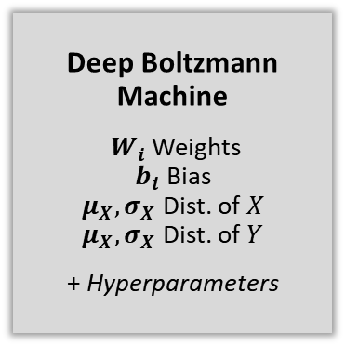
Energy based Calibration
Modelling Non-Linear Decorrelation
Approach 2: Undirected Graphical Model
Undirected mapping to latent space
Regard the mapping between features and the bottleneck layer mutually and minimize Energy
Generalizable!
equally considers information from different features
Deep Boltzmann Machine
$W_{i}$ Weights $b_{i}$ Bias $μ_{X},σ_{X}$ Dist. of $X$ $μ_{X},σ_{X}$ Dist. of $Y$
+ Hyperparameters

Slide 70
Energy based Calibration
Modelling Non-Linear Decorrelation
Approach 2: Undirected Graphical Model
?
Undirected mapping to latent space
Regard the mapping between features and the bottleneck layer mutually and minimize Energy
Generalizable!
equally considers information from different features
Deep Boltzmann Machine
$W_{i}$ Weights $b_{i}$ Bias $μ_{X},σ_{X}$ Dist. of $X$ $μ_{X},σ_{X}$ Dist. of $Y$
+ Hyperparameters

Slide 71
Energy based Calibration
Modelling Non-Linear Decorrelation
Approach 2: Undirected Graphical Model
?
Undirected mapping to latent space
Regard the mapping between features and the bottleneck layer mutually and minimize Energy
Generalizable!
equally considers information from different features
Example
Let $X_{1}$ and $X_{2}$ be highly similar
Deep Boltzmann Machine
$W_{i}$ Weights $b_{i}$ Bias $μ_{X},σ_{X}$ Dist. of $X$ $μ_{X},σ_{X}$ Dist. of $Y$
+ Hyperparameters

Slide 72
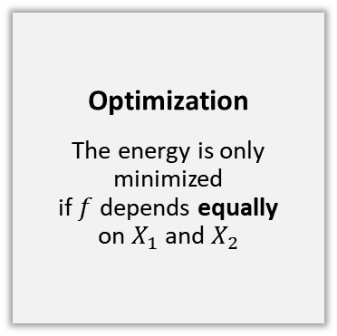
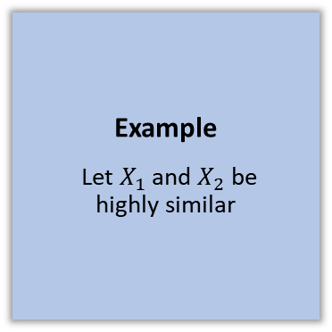
Energy based Calibration
Modelling Non-Linear Decorrelation
Approach 2: Undirected Graphical Model
?
Undirected mapping to latent space
Regard the mapping between features and the bottleneck layer mutually and minimize Energy
Generalizable!
equally considers information from different features
Example
Let $X_{1}$ and $X_{2}$ be highly similar
Deep Boltzmann Machine
$W_{i}$ Weights $b_{i}$ Bias $μ_{X},σ_{X}$ Dist. of $X$ $μ_{X},σ_{X}$ Dist. of $Y$
+ Hyperparameters
Optimization
The energy is only minimized if $f$ depends equally on $X_{1}$ and $X_{2}$

Slide 73
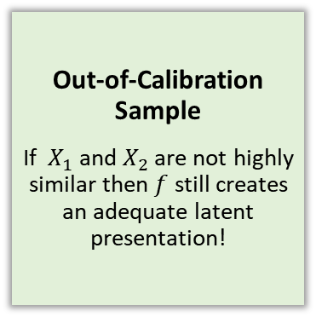
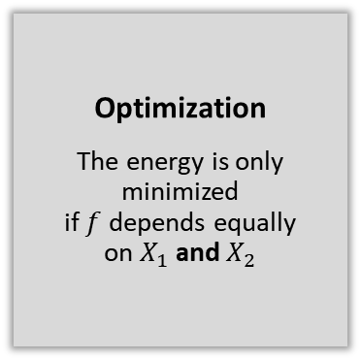
Energy based Calibration
Modelling Non-Linear Decorrelation
Approach 2: Undirected Graphical Model
!
Undirected mapping to latent space
Regard the mapping between features and the bottleneck layer mutually and minimize Energy
Generalizable!
equally considers information from different features
Example
Let $X_{1}$ and $X_{2}$ be highly similar
Out-of-Calibration Sample
If $X_{1}$ and $X_{2}$ are not highly similar then $f$ still creates an adequate latent presentation!
Deep Boltzmann Machine
$W_{i}$ Weights $b_{i}$ Bias $μ_{X},σ_{X}$ Dist. of $X$ $μ_{X},σ_{X}$ Dist. of $Y$
+ Hyperparameters
Optimization
The energy is only minimized if $f$ depends equally on $X_{1}$ and $X_{2}$

Slide 74
Energy based Calibration
What is Energy based Modeling?

Slide 75
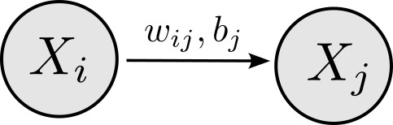
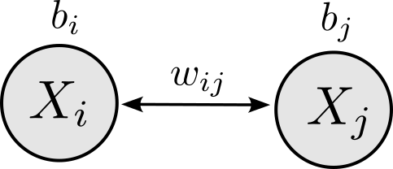
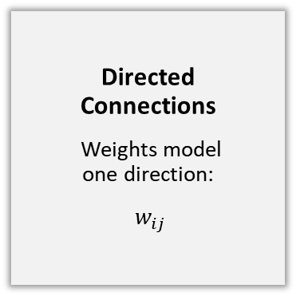
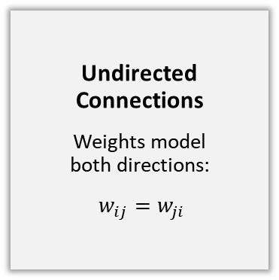
Energy based Calibration
Energy based Modeling
Regression Model
Directed Connections
Weights model one direction:
$w_{ij}$
Undirected Connections
Weights model both directions:
$w_{ij}=w_{ji}$
Energy based Model

Slide 76
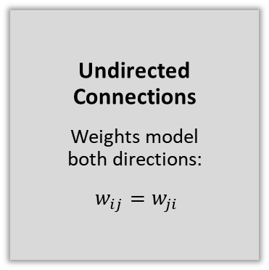


Energy based Calibration
Energy based Modeling
Regression Model
Minimizes Error
Parameters minimize the error between targets and predictions
Directed Connections
Weights model one direction:
$w_{ij}$
Undirected Connections
Weights model both directions:
$w_{ij}=w_{ji}$
Minimizes Energy
Parameters minimize the pairwise energies of connected vertices:
Pos. Corr.: $w_{ij}>0$ Neg. Corr.: $w_{ij} <0$
Energy based Model

Slide 77

Energy based Calibration
Energy based Modeling
Regression Model
Minimizes Error
Parameters minimize the error between targets and predictions
Calculates Predictions
Predictions of targets are directly calculated
Directed Connections
Weights model one direction:
$w_{ij}$
Undirected Connections
Weights model both directions:
$w_{ij}=w_{ji}$
Minimizes Energy
Parameters minimize the pairwise energies of connected vertices:
Pos. Corr.: $w_{ij}>0$ Neg. Corr.: $w_{ij} <0$
Approximates Predictions
Predictions of all variables are approximated by a Markov Chain using Gibbs Sampling
Energy based Model

Slide 78
Energy based Calibration
Energy based Modeling
Regression Model
Minimizes Error
Parameters minimize the error between targets and predictions
Calculates Predictions
Predictions of targets are directly calculated
Optimizes Prediction Function
Gradient Descent in the Errorlandscape approximates the prediction function
Directed Connections
Weights model one direction:
$w_{ij}$
Undirected Connections
Weights model both directions:
$w_{ij}=w_{ji}$
Minimizes Energy
Parameters minimize the pairwise energies of connected vertices:
Pos. Corr.: $w_{ij}>0$ Neg. Corr.: $w_{ij} <0$
Approximates Predictions
Predictions of all variables are approximated by a Markov Chain using Gibbs Sampling
Optimizes Joint Distribution
Gradient Descent in the Energylandscape approximates the joint distributon
Energy based Model

Slide 79
Energy Based Calibration
Non-linear Regression in Energy based Calibration

Slide 80
Energy Based Calibration
Non-linear Regression
Consists of two Parts

Slide 81
Energy Based Calibration
Non-linear Regression
Part 1: Embedding
Non-linear decorrelation by Energy based model
Spec2Vec
Consists of two Parts

Slide 82

Energy Based Calibration
Non-linear Regression
Part 1: Embedding
Non-linear decorrelation by Energy based model
Spec2Vec
Consists of two Parts
Part 2: Regression
Non-linear regression by deep neural network (e.g. transformer etc.)

Slide 83
Energy Based Calibration
What can be concluded about Energy based Calibration?

Slide 84
Energy Based Calibration
Conclusions
Non-Linear Decorrelation
Energy based modeling allows non-linear decorrelation of spectral features

Slide 85
Energy Based Calibration
Conclusions
Non-Linear Decorrelation
Energy based modeling allows non-linear decorrelation of spectral features
Increases Signal-to-Noise ratio
Non-linear decorrelation allows the separation of skewed noise (non-Gaussian)

Slide 86
Energy Based Calibration
Conclusions
Non-Linear Regression
Non-linear decorrelation allows non-linear regression of chemical features, e.g. by Neural Networks (Transformers, etc.)
Non-Linear Decorrelation
Energy based modeling allows non-linear decorrelation of spectral features
Increases Signal-to-Noise ratio
Non-linear decorrelation allows the separation of skewed noise (non-Gaussian)

Slide 87
Energy Based Calibration
Conclusions
Non-Linear Regression
Non-linear decorrelation allows non-linear regression of chemical features, e.g. by Neural Networks (Transformers, etc.)
Intricates Feature Selection
The non-linearity intricates the selection of non-linear spectral features
Non-Linear Decorrelation
Energy based modeling allows non-linear decorrelation of spectral features
Increases Signal-to-Noise ratio
Non-linear decorrelation allows the separation of skewed noise (non-Gaussian)

Slide 88
Energy Based Calibration
Conclusions
Non-Linear Regression
Non-linear decorrelation allows non-linear regression of chemical features, e.g. by Neural Networks (Transformers, etc.)
Non-linear Feature Selection?
Intricates Feature Selection
The non-linearity intricates the selection of non-linear spectral features
Non-Linear Decorrelation
Energy based modeling allows non-linear decorrelation of spectral features
Increases Signal-to-Noise ratio
Non-linear decorrelation allows the separation of skewed noise (non-Gaussian)

Slide 89
Energy Based Calibration
Conclusions
Non-Linear Regression
Non-linear decorrelation allows non-linear regression of chemical features, e.g. by Neural Networks (Transformers, etc.)
Non-linear Feature Selection?
Intricates Feature Selection
The non-linearity intricates the selection of non-linear spectral features
Non-Linear Decorrelation
Energy based modeling allows non-linear decorrelation of spectral features
Increases Signal-to-Noise ratio
Non-linear decorrelation allows the separation of skewed noise (non-Gaussian)
Intricates Sample Selection
The non-linearity intricates the selection of calibration samples and thus the experimental design

Slide 90
Energy Based Calibration
Conclusions
Non-Linear Regression
Non-linear decorrelation allows non-linear regression of chemical features, e.g. by Neural Networks (Transformers, etc.)
Non-linear Feature Selection?
Intricates Feature Selection
The non-linearity intricates the selection of non-linear spectral features
Non-Linear Decorrelation
Energy based modeling allows non-linear decorrelation of spectral features
Increases Signal-to-Noise ratio
Non-linear decorrelation allows the separation of skewed noise (non-Gaussian)
Intricates Sample Selection
The non-linearity intricates the selection of calibration samples and thus the experimental design
Bayesian Sample Selection?

Slide 91
Non-linear feature selection
Part 4
Non-linear feature selection

Slide 92
Non-linear feature selection
Differential Geometric feature selection for Principal Components

Slide 93

Non-linear feature selection
Differential Geometric feature selection (linear)
Example (Line)
Feature Selection for Principal Component

Slide 94
Non-linear feature selection
Differential Geometric feature selection (linear)
Example (Line)
Feature Selection for Principal Component
Approach 1: Statistical
Calculate empirical correlations:

Slide 95


Non-linear feature selection
Differential Geometric feature selection (linear)
Example (Line)
Feature Selection for Principal Component
Approach 1: Statistical
Calculate empirical correlations:
$corr(\hat{X},X)$

Slide 96


Non-linear feature selection
Differential Geometric feature selection (linear)
Example (Line)
Feature Selection for Principal Component
Approach 1: Statistical
Calculate empirical correlations:
$corr\left(\hat{X},X\right)>corr\left(\hat{X},Y\right)$

Slide 97

Non-linear feature selection
Differential Geometric feature selection (linear)
Example (Line)
Feature Selection for Principal Component
Does not allow generalization to non-linearity!
Due to missing non-linear empirical correlation
Approach 1: Statistical
Calculate empirical correlations:
$corr\left(\hat{X},X\right)>corr\left(\hat{X},Y\right)$

Slide 98
Non-linear feature selection
Differential Geometric feature selection (linear)
Example (Line)
Feature Selection for Principal Component
Approach 2: Geometrical
Calculate partial derivatives:

Slide 99


Non-linear feature selection
Differential Geometric feature selection (linear)
Example (Line)
Feature Selection for Principal Component
Approach 2: Geometrical
Calculate partial derivatives:
$\left|\frac{∂}{∂X}\hat{X}\right|$

Slide 100


Non-linear feature selection
Differential Geometric feature selection (linear)
Example (Line)
Feature Selection for Principal Component
Approach 2: Geometrical
Calculate partial derivatives:
$\left|\frac{∂}{∂X}\hat{X}\right|>\left|\frac{∂}{∂Y}\hat{X}\right|$

Slide 101

Non-linear feature selection
Differential Geometric feature selection (linear)
Example (Line)
Feature Selection for Principal Component
Allows generalization to non-linearity!
The partial derivative can be integrated over an underlying principal manifold
Approach 2: Geometrical
Calculate partial derivatives:
$\left|\frac{∂}{∂X}\hat{X}\right|>\left|\frac{∂}{∂Y}\hat{X}\right|$

Slide 102
Non-linear feature selection
Differential Geometric feature selection for Principal Manifolds

Slide 103

Non-linear feature selection
Differential Geometric feature selection (non-linear)
Example (Curve)
Feature Selection for Principal Curve

Slide 104
Non-linear feature selection
Differential Geometric feature selection (non-linear)
Example (Curve)
Feature Selection for Principal Curve
Approach 1: Analytical Integration
Calculate integrals of partial derivatives along curve

Slide 105

Non-linear feature selection
Differential Geometric feature selection (non-linear)
Example (Curve)
Feature Selection for Principal Curve
Approach 1: Analytical Integration
Calculate integrals of partial derivatives along curve

Slide 106

Non-linear feature selection
Differential Geometric feature selection (non-linear)
Example (Curve)
Feature Selection for Principal Curve
Not Computable!
Individual outcomes of $\hat{X}$are to be computed by Gibbs Sampling
Approach 1: Analytical Integration
Calculate integrals of partial derivatives along curve

Slide 107
Non-linear feature selection
Differential Geometric feature selection (non-linear)
Example (Curve)
Feature Selection for Principal Curve

Slide 108
Non-linear feature selection
Differential Geometric feature selection (non-linear)
Example (Curve)
Feature Selection for Principal Curve
Approach 2: Monte Carlo Integration
Approximate integrals of partial derivatives along curve

Slide 109

Non-linear feature selection
Differential Geometric feature selection (non-linear)
Example (Curve)
Feature Selection for Principal Curve
Approach 2: Monte Carlo Integration
Approximate integrals of partial derivatives along curve

Slide 110
Non-linear feature selection
Differential Geometric feature selection (non-linear)
Example (Curve)
Feature Selection for Principal Curve
Allows non-linear feature selection!
The empirical means converge towards the integrals under mild conditions
Approach 2: Monte Carlo Integration
Approximate integrals of partial derivatives along curve

Slide 111
Non-linear feature selection
What can be concluded about non-linear feature selection?

Slide 112
Non-linear feature selection
Conclusions
Feature Selection
for non-linear models works!

Slide 113
Non-linear feature selection
Conclusions
Sufficiency
The non-linearity allows higher accuracy at same number of spectral features
Feature Selection
for non-linear models works!

Slide 114
Non-linear feature selection
Conclusions
Improves Parallel Measures
e.g. by diffraction grating
Sufficiency
The non-linearity allows higher accuracy at same number of spectral features
Feature Selection
for non-linear models works!

Slide 115
Non-linear feature selection
Conclusions
Improves Parallel Measures
e.g. by diffraction grating
Sufficiency
The non-linearity allows higher accuracy at same number of spectral features
Feature Selection
for non-linear models works!
Efficiency
The non-linearity allows fewer spectal features at same accuracy

Slide 116
Non-linear feature selection
Conclusions
Improves Parallel Measures
e.g. by diffraction grating
Sufficiency
The non-linearity allows higher accuracy at same number of spectral features
Feature Selection
for non-linear models works!
Efficiency
The non-linearity allows fewer spectal features at same accuracy
Accelerates Sequential Measures

Slide 117
Bayesian sample selection
Part 5
Bayesian sample selection

Slide 118
Bayesian sample selection
Bayesian Experimental Design

Slide 119
Bayesian sample selection
Bayesian Experimental Design
Initial Selection of calibration samples

Slide 120
Bayesian sample selection
Bayesian Experimental Design
Initial Selection of calibration samples
Determine confidence within validation samples
using quantile loss

Slide 121

Bayesian sample selection
Bayesian Experimental Design
Initial Selection of calibration samples
Determine confidence within validation samples
using quantile loss
Backpropagate uncertainty to spectral features
using quantile loss and non-linear feature selection

Slide 122

Bayesian sample selection
Bayesian Experimental Design
Initial Selection of calibration samples
Determine confidence within validation samples
using quantile loss
Backpropagate uncertainty to spectral features
using quantile loss and non-linear feature selection
Add calibration samples with distinct features

Slide 123
Bayesian sample selection
Conclusions about Bayesian sample selection

Slide 124
Bayesian sample selection
Conclusions
Iteratively increases Confidence in Validation Predictions
by Bayesian Optimization

Slide 125
Bayesian sample selection
Conclusions
Can lead to Overfitting of Validation samples
Iteratively increases Confidence in Validation Predictions
by Bayesian Optimization

Slide 126
Bayesian sample selection
Conclusions
Can lead to Overfitting of Validation samples
How to avoid Overfitting?
Additional Test Samples? Changes in Validation Samples?
Iteratively increases Confidence in Validation Predictions
by Bayesian Optimization

Slide 127
Bayesian sample selection
Conclusions
Can lead to Overfitting of Validation samples
How to avoid Overfitting?
Additional Test Samples? Changes in Validation Samples?
Iteratively increases Confidence in Validation Predictions
by Bayesian Optimization
Intricates scheduling in product development

Slide 128
Bayesian sample selection
Conclusions
Can lead to Overfitting of Validation samples
How to avoid Overfitting?
Additional Test Samples? Changes in Validation Samples?
Iteratively increases Confidence in Validation Predictions
by Bayesian Optimization
Intricates scheduling in product development
When to stop Iterations?
Elbow method? Fixed number of iterations?

Slide 129
Summary
Summary

Slide 130
Summary
#1
Neural networks are by themselves not suitable for multivariate calibration in NIR due to missing generalizability

Slide 131
Summary
#1
Neural networks are by themselves not suitable for multivariate calibration in NIR due to missing generalizability
#2
A preceded embedding step with deep non-linear decorrelation using energy based modeling fixes this issue

Slide 132
Summary
#1
Neural networks are by themselves not suitable for multivariate calibration in NIR due to missing generalizability
#3
The incorporation of non-linearity increases the accuracy and the efficiency of predictions
#2
A preceded embedding step with deep non-linear decorrelation using energy based modeling fixes this issue

Slide 133
Summary
#1
Neural networks are by themselves not suitable for multivariate calibration in NIR due to missing generalizability
#3
The incorporation of non-linearity increases the accuracy and the efficiency of predictions
#2
A preceded embedding step with deep non-linear decorrelation using energy based modeling fixes this issue
#4
The incorporation of non-linearity intricates feature selection and the design of experiments

Slide 134

Thank you for your attention!

